Slide 1
ELECTRICAL SCIENCE-1 (15B11EC111) UNIT-1 Lecture-5

Slide 2
Topics to be Discussed
Kirchhoff’s Laws
Kirchhoff’s Current Law (KCL)
Kirchhoff’s Voltage Law (KVL)
Problems and solutions
Practice Problems
References

Slide 3
Kirchhoff’s Laws
In 1847, Gustav Robert Kirchhoff, a professor at the University of Berlin, formulated two important laws that provide the foundation for analysis of electric circuits. These laws are referred to as Kirchhoff’s current law (KCL) and Kirchhoff’s voltage law (KVL).
Kirchhoff’s laws are a consequence of conservation of charge and conservation of energy
Kirchhoff’s current law states that the algebraic sum (i.e taking reference directions into account) of the currents entering any node is identically zero for all instants of time.
Kirchhoff’s current law (KCL): The algebraic sum of the currents into a node at any instant is zero.

Slide 4
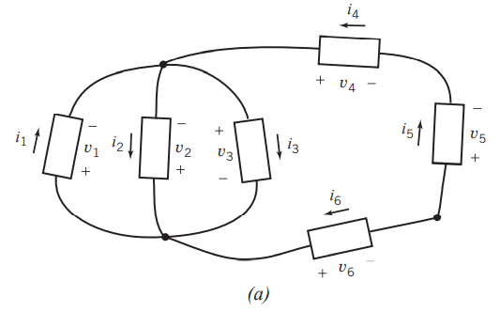
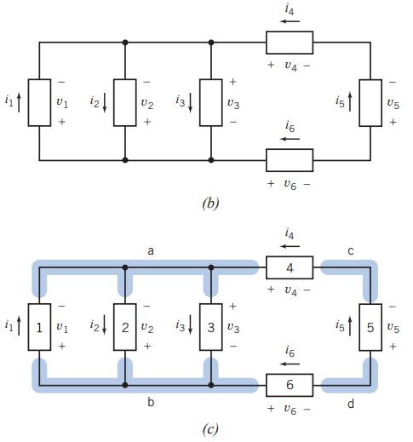
Kirchhoff’s Laws…
Figure (a) shows an electric circuit that consists of six elements connected together at four nodes. It is common practice to draw electric circuits using straight lines and to position the elements horizontally or vertically as shown in Figure (b).
FIGURE (a) An electric circuit. (b) The same circuit, redrawn using straight lines and horizontal and vertical elements. (c) The circuit after labeling the nodes and elements.

Slide 5
Kirchhoff’s Current Law (KCL)
Consider the same circuit after labeling the nodes and elements in Figure (c). Four elements of this circuit 1, 2, 3, and 4 are connected to node a.
By Kirchhoff’s current law, the algebraic sum of the element currents i₁, i₂, i₃, and i₄ must be zero.
Currents i₂ and i₃ are directed away from node a, so we will use a plus sign for i₂ and i₃. In contrast, currents i₁ and i₄ are directed toward node a, so we will use a minus sign for i₁ and i₄.
The KCL equation for node a of Figure c is
-i₁+i₂+i₃-i₄=0

Slide 6
Kirchhoff’s Current Law (KCL)
An alternate way is to set the sum of all the currents directed away from the node equal to the sum of all the currents directed toward that node.
i₂+i₃= i₁+i₄
Similarly, the Kirchhoff’s current law equation for node b
i₁ = i₂+i₃+i₆

Slide 7
Kirchhoff’s Voltage Law (KVL)
Kirchhoff’s voltage law (KVL): The algebraic sum of the voltages around any loop in a circuit is identically zero for all time.
The phrase algebraic sum indicates that we must take polarity into account as we add up the voltages of elements that comprise a loop.
One way to take polarity into account is to move around the loop in the clockwise direction while observing the polarities of the element voltages.
For example, consider the circuit shown in Figure c. Elements 3, 4, 5, and 6 comprise a loop of the circuit. By Kirchhoff’s voltage law, the algebraic sum of the element voltages v₃, v₄, v₅, and v₆ must be zero.
v₄ - v₅ - v₆ - v₃ =0
Similarly, the KVL equation for
the loop consisting of (1, 4, 5, 6) is
v₄ - v₅ - v₆ + v₁ =0
the loop consisting of (1 and 2) is
- v₂ + v₁ =0

Slide 8
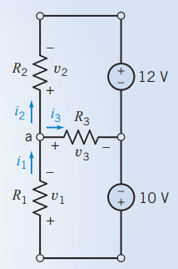
Problems
Problem 1. Consider the circuit shown in Figure. Notice that the passive convention was used to assign reference directions to the resistor voltages and currents. This anticipates using Ohm’s law. Find each current and each voltage when R₁ = 8 V, v₂ = -10 V, i₃ = 2 A, and R₃ = 1 V. Also, determine the resistance R₂.
Solution: The sum of the currents entering node a is
i1- i2- i3 =0
Using Ohm’s law for R₃, we find that v₃ = R₃i₃ = 1(2) = 2 V
Kirchhoff’s voltage law for the bottom loop incorporating v₁, v₃, and the 10-V source is
-10 + v₁ + v₃ = 0
Therefore; v₁ = 10 - v₃ = 8 V
Ohm’s law for the resistor R₁ is v₁ = R₁i₁
or i₁ = v₁/R₁ = 8/8 = 1 A
Next, apply Kirchhoff’s current law at node a to get
i₂ = i₁ - i₃ = 1-2 = -1 A
We can now find the resistance R₂ from v₂ = R₂i₂ or
R₂ = v₂/i₂ = -10/-1 = 10Ω

Slide 9
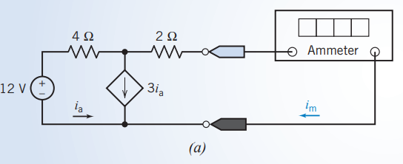
Problems
Problem 2. Determine the value of the current, in amps, measured by the ammeter in Figure a.

Slide 10
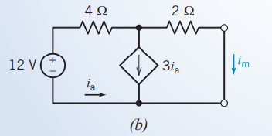
Problems…
Solution:
An ideal ammeter is equivalent to a short circuit. The current measured by the ammeter is the current in the short circuit.
Figure b shows the circuit after replacing the ammeter by the equivalent short circuit.

Slide 11
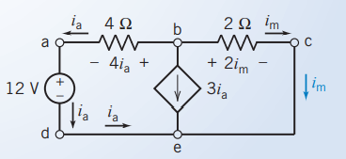
Problems…
Solution …
The circuit has been redrawn in Figure (c) to label the nodes of the circuit. This circuit consists of a voltage source, a dependent current source, two resistors, and two short circuits. One of the short circuits is the controlling element of the CCCS, and the other short circuit is a model of the ammeter.
Applying KCL twice, once at node d and again at node a, shows that the current in the voltage source and the current in the 4Ω resistor are both equal to i_{a}.
Applying KCL again, at node c, shows that the current in the 2Ω resistor is equal to i_{m}.
(c)

Slide 12
Problems…
Solution …
Next, Ohm’s law tells us that the voltage across the 4Ω resistor is equal to 4i_{a} and that the voltage across the 2Ω resistor is equal to 2i_{m}.
Applying KCL at node b gives
- i_{a} -3i_{a} - i_{m} = 0
Applying KVL to closed path a-b-c-e-d-a gives
0 = 4i_{a} + 2i_{m} -12 = -4(- i_{m} /4) + 2i_{m} - 12 = 3i_{m} - 12
Finally, solving this equation gives i_{m} = 4 A

Slide 13
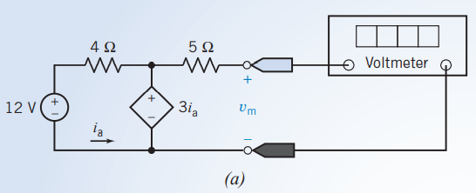
Problems…
Problem 3. Determine the value of the voltage, in volts, measured by the voltmeter in Figure a.

Slide 14
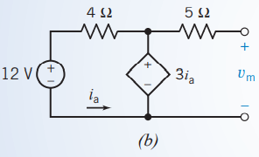
Problems…
Solution: An ideal voltmeter is equivalent to an open circuit. The voltage measured by the voltmeter is the voltage across the open circuit.
Figure shows the circuit after replacing the voltmeter by the equivalent open circuit.
This circuit consists of a voltage source, a dependent voltage source, two resistors, a short circuit, and an open circuit.
The short circuit is the controlling element of the CCVS, and the open circuit is a model of the voltmeter.

Slide 15
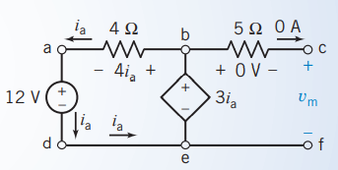
Problems…
Solution …
The circuit has been redrawn in Figure to label the nodes of the circuit.
Applying KCL twice, once at node d and again at node a, shows that the current in the voltage source and the current in the 4Ω resistor are both equal to i_{a}.
Applying KCL again, at node c, shows that the current in the 5Ω resistor is equal to the current in the open circuit, that is, zero.
Ohm’s law tells us that the voltage across the 5Ω resistor is also equal to zero.
Next, applying KVL to the closed path b-c-f-e-b gives v_{m} = 3i_{a}.
Applying KVL to the closed path a-b-e-d-a gives -4i_{a} + 3i_{a} -12 = 0
so i_{a} = -12 A Finally v_{m} = 3i_{a} = 3(-12) = -36 V

Slide 16
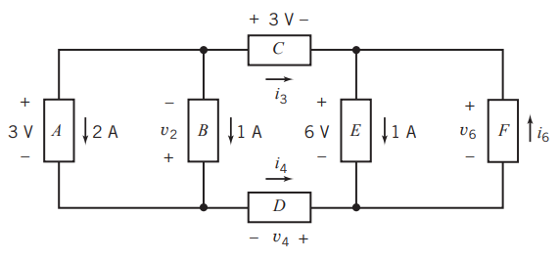
Practice Problem
Problem 1. Determine the values of i₃, i₄, i₆, v₂, v₄, and v₆ in Figure shown. Answer: i₃ = 3 A, i₄ = 3 A, i₆ = 4 A, v₂ = 3 V, v₄ = 6 V, v₆ = 6 V

Slide 17
REFERENCES
[1]R.C. Dorf and James A. Svoboda, “Introduction to Electric Circuits”, 9th ed, John Wiley & Sons, 2013.

